Slide 1
Conditionals

Slide 2
Zero Conditional
The Zero conditional is used for things that are always true as long as the condition is met.
Form:
[if + present simple], [present simple]
Example:
If you heat water until 100 degrees Celsius, it boils.
If I drink too much coffee, I get a headache.

Slide 3
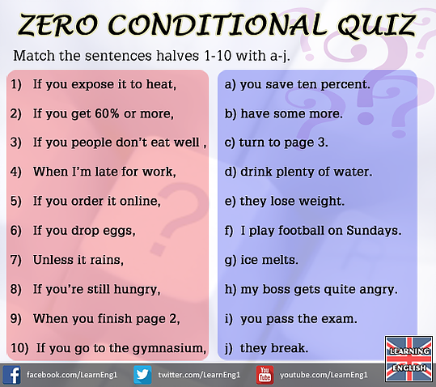

Slide 4
First Conditional
The First Conditional is used to predict the result of a future action (things which might happen in the future).
Form:
[if + present simple], [will + infinitive]
Example:
If she gets good grades, she will go to university.
You’ll fail the exam if you don’t do more work.

Slide 5
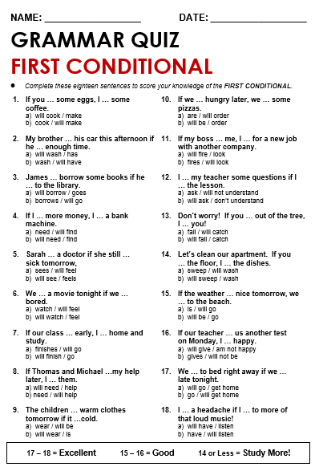

Slide 6
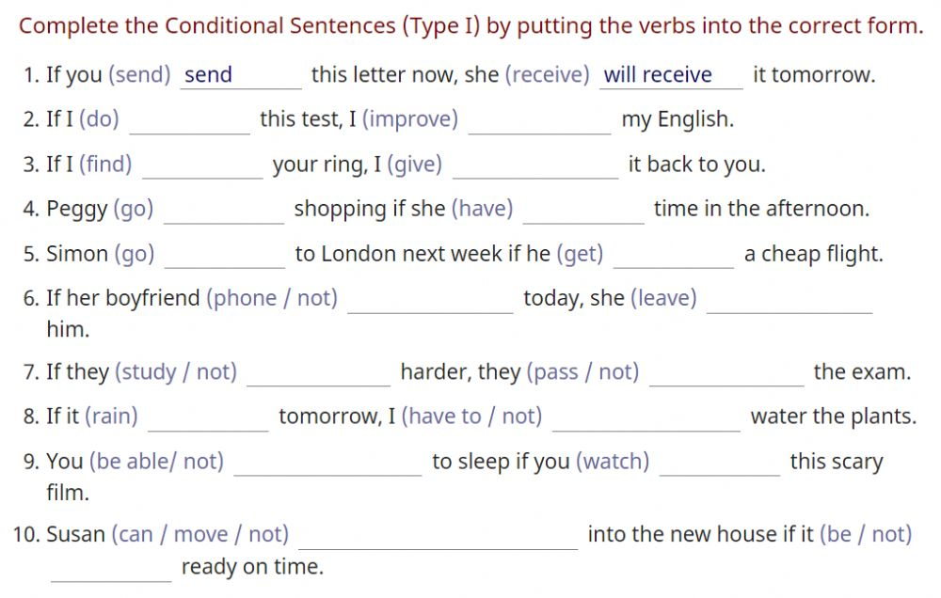

Slide 7
Second conditional
The Second conditional is used to talk about situations that are unlikely or unreal. It can refer to the present or the future.
Form:
[if + past simple], [would + infinitive]
Example:
If I were you, I wouldn’t do it.
I would learn Italian, if I had the time.

Slide 8
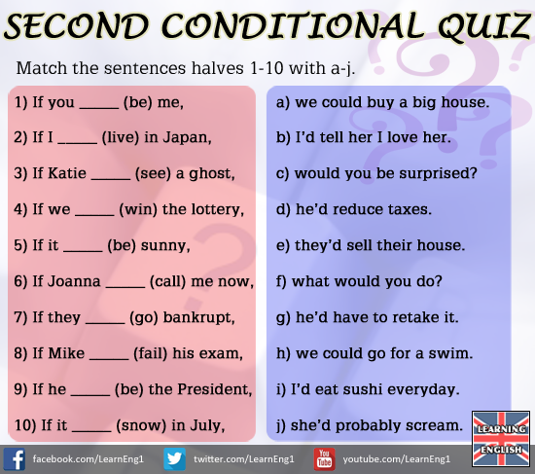

Slide 9
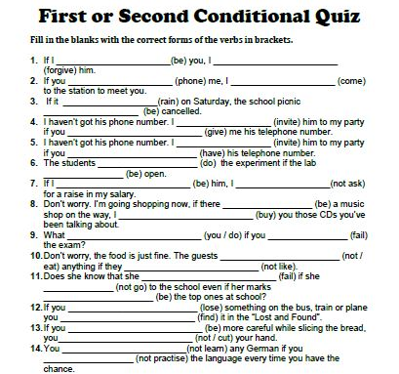

Slide 10
Third Conditional
The Third Conditional is used to speculate about the imaginary result of things which didn’t happen.
Form:
[if + past perfect], [would have + past participle]
Example:
If you had studied harder, you would have passed your exams.
We wouldn’t have been late, if we hadn’t missed the bus.

Slide 11
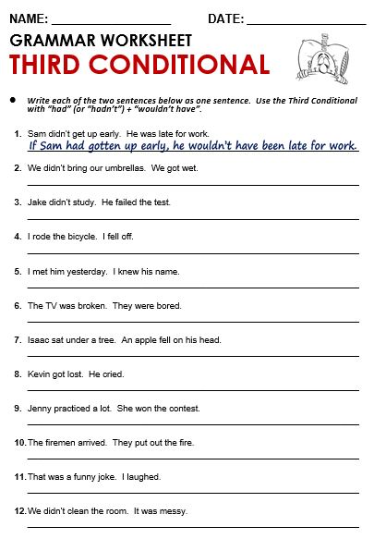

Slide 12
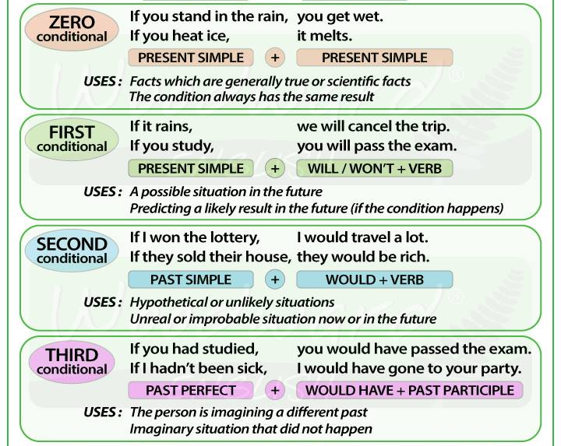

Slide 13
Practice makes Perfect!
https://www.englisch-hilfen.de/en/exercises_list/if.htm
http://www.myenglishpages.com/site_php_files/grammar-exercise-conditionals.php
https://www.ego4u.com/en/cram-up/tests/conditional-sentences-3
https://www.ego4u.com/en/cram-up/grammar/conditional-sentences

Slide 14
Mixed conditionals
Second conditional
-> [if + past simple], [would + infinitive]
-> present/future situations
Third conditional
-> [if + past perfect], [would + have + past participle]
-> past situations

Slide 15
Mixed conditionals
Third conditional (past)
If I had studied harder, I would have passed my exam.
Mixed conditional (past condition, present/future result)
If I had studied harder, I would pass my exam.
Second conditional (present)
If she had enough money, she could buy a new car.
Mixed conditional (present condition, past result)
If she had enough money, she could have bought a new car long ago.

Slide 16
Mixed conditionals
[if + past perfect], [would + infinitive]
past condition, present/future result
This type of mixed conditional refers to an unreal past condition and its probable result in the present/future.
In these mixed conditional sentences, the time is the past in the "if" clause and in the present in the main clause.
If I had worked harder at school, I would have a better job now.
If we had looked at the map we wouldn't be lost.
You would be dead now if you had caught that plane.
If I had taken an aspirin, I wouldn't have a headache now.

Slide 17
Mixed conditionals
[if + past simple], [would + have + past participle]
present condition, past result
These mixed conditional sentences refer to an unreal present situation and its probable (but unreal) past result.
In these mixed conditional sentences, the time in the if clause is now or always and the time in the main clause is before now.
If I wasn't afraid of spiders, I would have picked it up.
If we didn't trust him, we would have sacked him months ago.
I would have been happy to help you if I wasn't in the middle of another meeting.
If I was a good cook, I'd have invited them to lunch.
If she had enough money, she could have done this trip to Hawaii.

Slide 18
Practice makes Perfect!
https://agendaweb.org/verbs/conditional-mixed-exercises.html
https://elt.oup.com/student/solutions/upperint/grammar/grammar_09_022e?cc=nl&selLanguage=nl
https://www.englishpage.com/conditional/conditionalintro.html

Slide 19
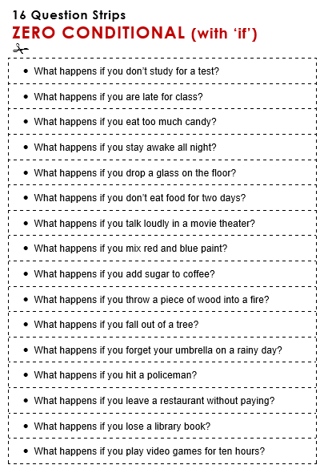

Slide 20
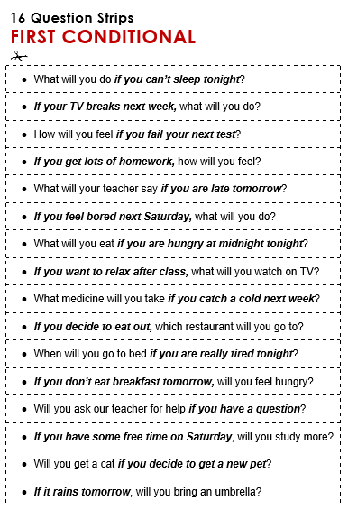

Slide 21
